Slide 1
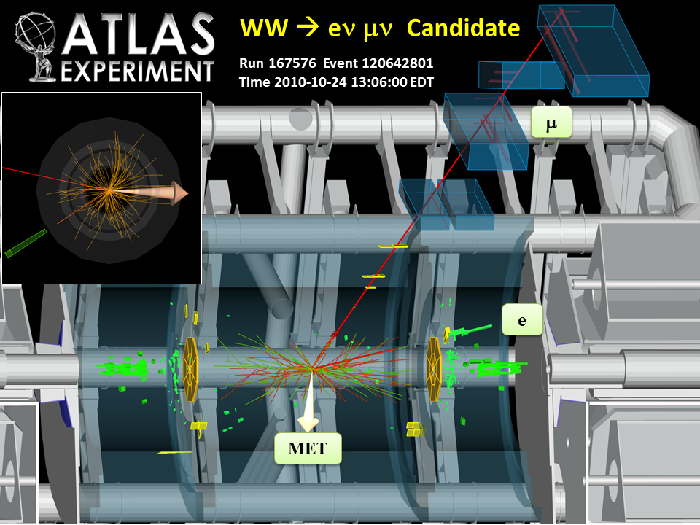

Higgs boson searches in the ATLAS experiment
- Recent results-
Karl Jakobs
Physikalisches Institut
Universität Freiburg

Slide 2
Outline:
Introduction, Data taking, ATLAS performance
Search for the Standard Model Higgs boson
- Focus on important channels in the low mass region
- Summary of searches in the high mass region
3. Combination of results
A few examples on recent searches for non-Standard Model Higgs
bosons

Slide 3
ATLAS data taking in 2011
Excellent LHC performance in 2011
(far beyond expectations)
Peak luminosity seen by ATLAS:
3.6 10³³ cm⁻² s⁻¹
1 fb⁻¹ line passed in June 2011
Excellent performance of ATLAS
Small fraction of non-working detector
channels (few per mille → 3.5%)
Data taking efficiency is high: ~93.5%
High fraction (90-96%) used for analysis
(good quality, depends on analysis)

Slide 4
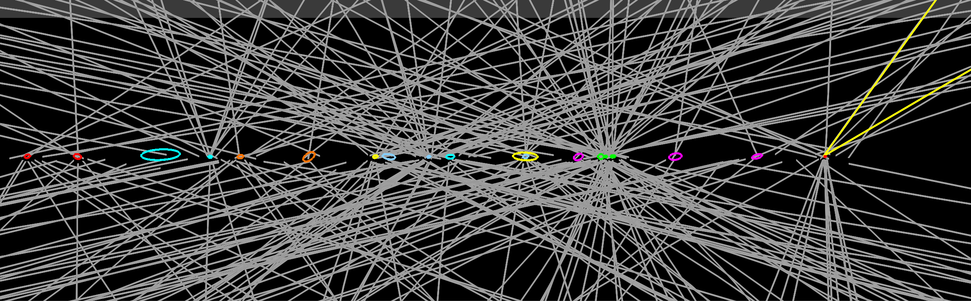
ATLAS running conditions in 2011
High peak luminosity and 50 ns bunch
spacing → high pile-up
Two running periods with different
machine settings
(period A (Mar - July): μ = 6.3,
period B (Aug. - Oct): μ = 11.6,
with tails beyond 20 interactions /
beam crossing, ~ design luminosity)
Very challenging for trigger, computing,
reconstruction of physics objects,…
An event with 20
reconstructed vertices
(error ellipses are scaled up
by a factor of 20 for visibility
reasons)
Z→ μμ

Slide 5
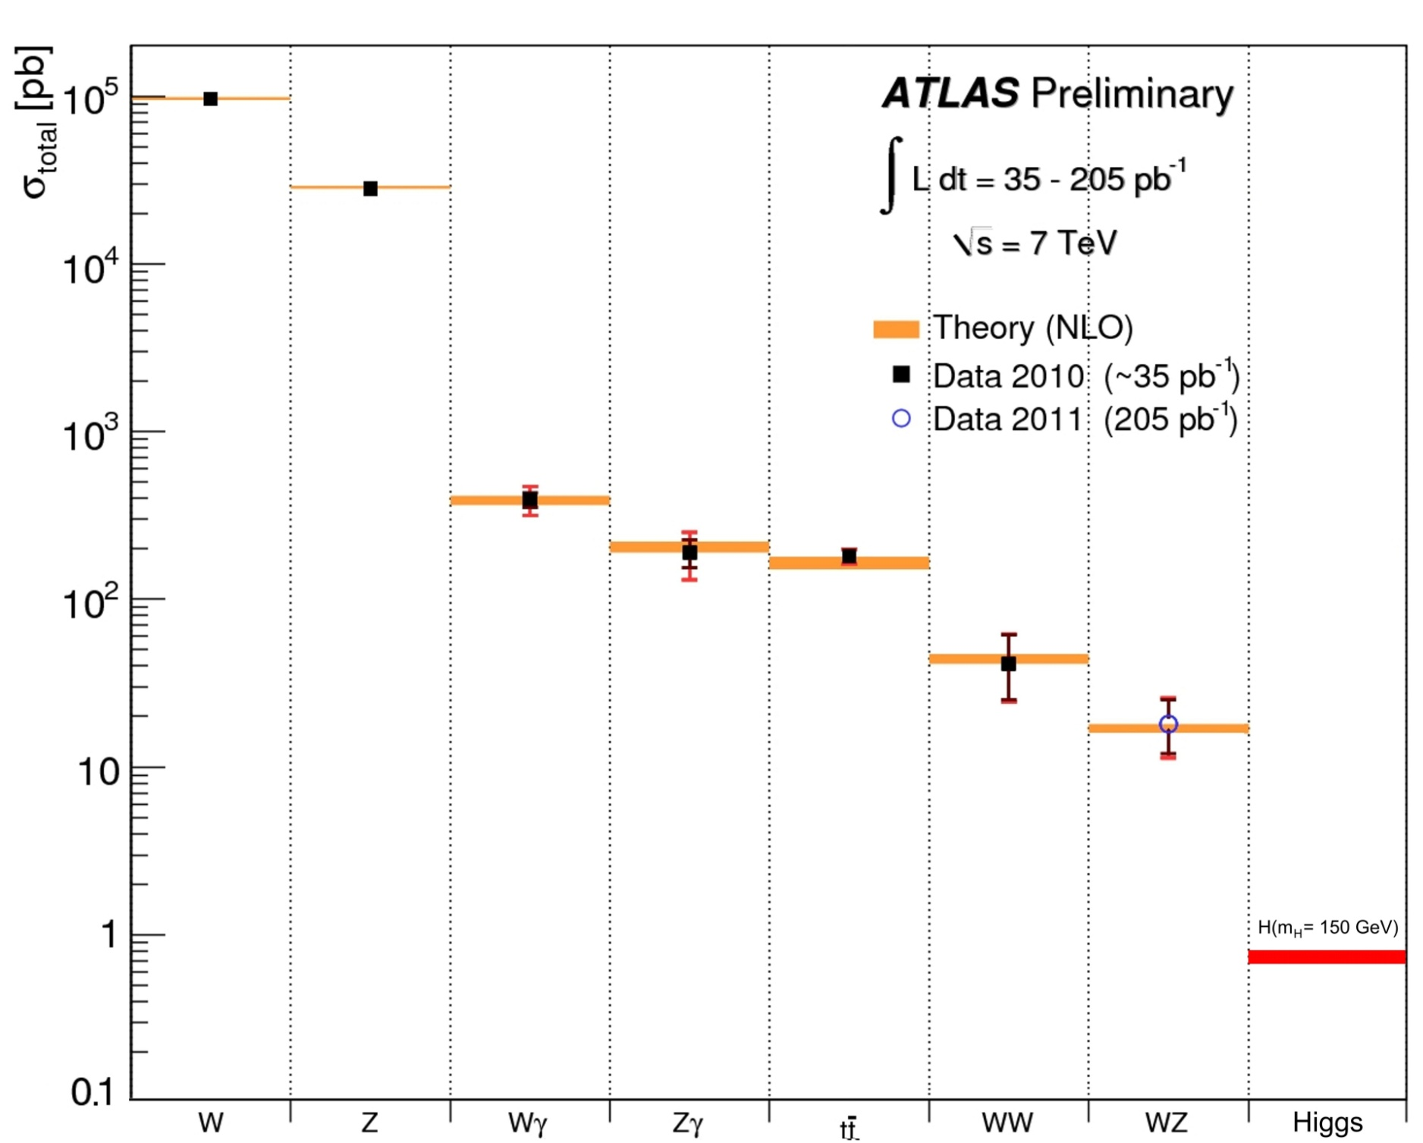
An impressive number of processes have already been measured
Excellent agreement with the Standard Model predictions
Important for background estimates in Higgs boson searches

Slide 6
Status of Higgs Boson searches
- based on results presented at the Summer Conferences 2011-
Higgs boson mass constraints: 114.4 < m_{H} < 141 GeV
(at 95% C.L.) .or. m_{H} > 476 GeV

Slide 7
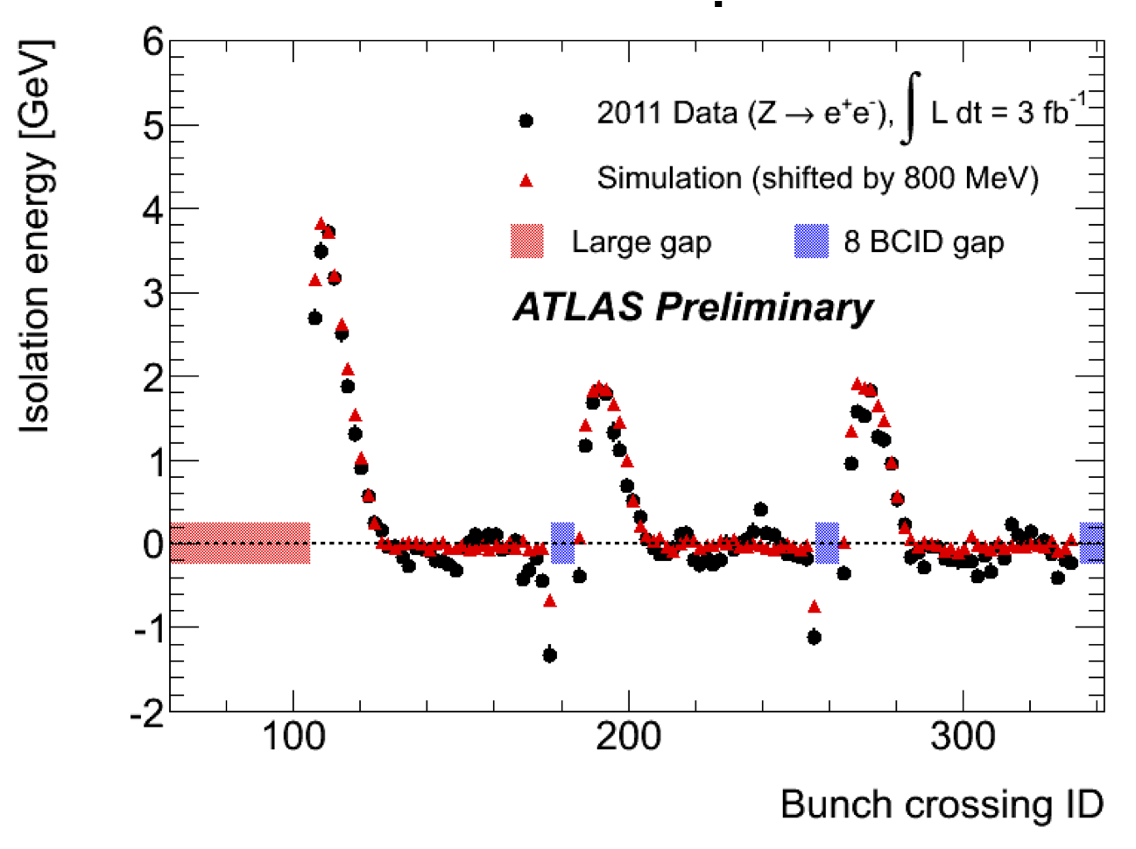
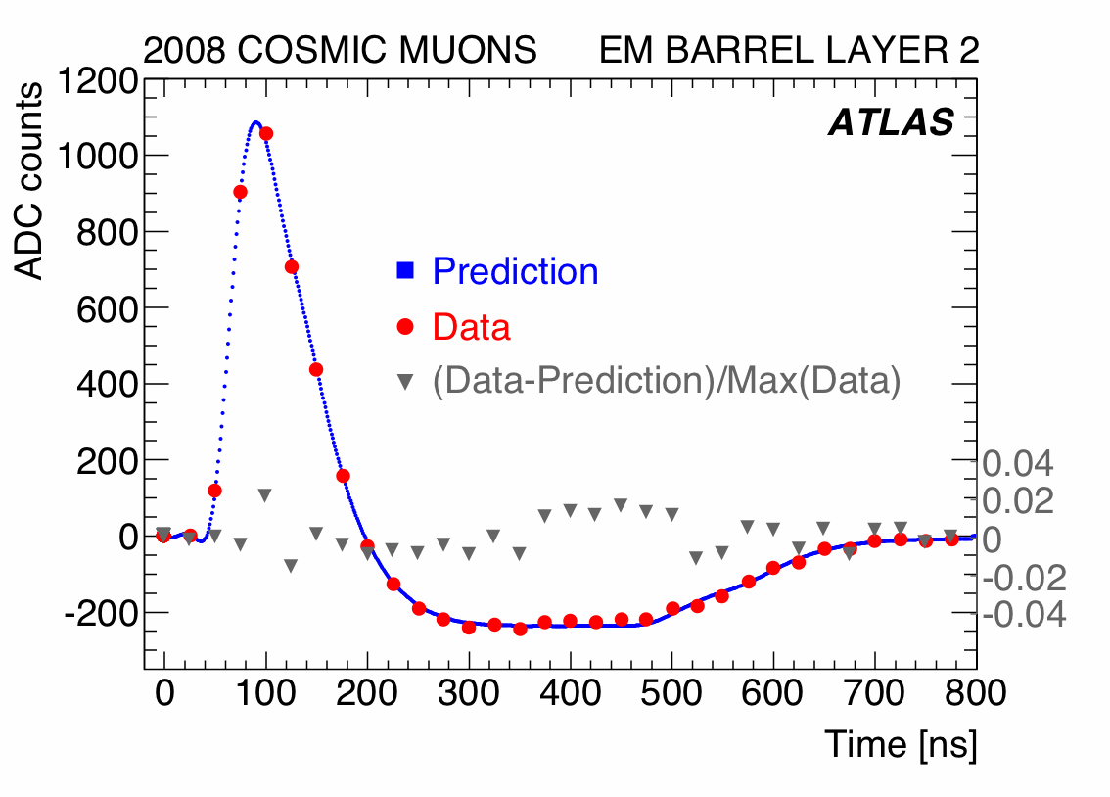
Updates on the analyses (since the Summer Conferences)
More data: analyses of some channels are based on the full 2011 data set
(up to 4.9 fb⁻¹)
Huge effort to improve the understanding of the detector performance
- 2011 data recorded with very different conditions compared to 2010
- Improved knowledge (of many subtle effects) propagated to the simulation
and reconstruction, e.g.
* in- and out-of-time pile-up, including bunch train structure (see below)
* new detector alignment
* better material description
* …
Example: pile-up energy in a cone around
e/γ candidates (isolation energy) depends on
the position in the bunch train
Calorimeter bipolar pulse shape:
average pile-up is zero over
~ 600 ns (~12 bunches)

Slide 8
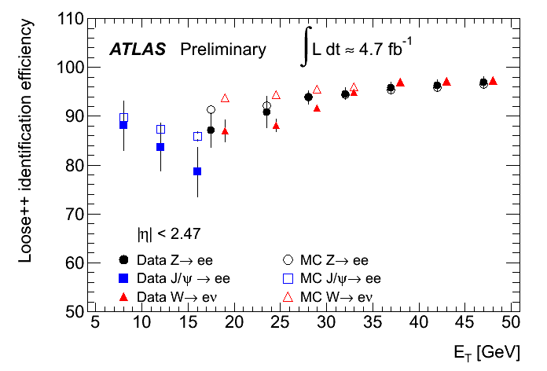
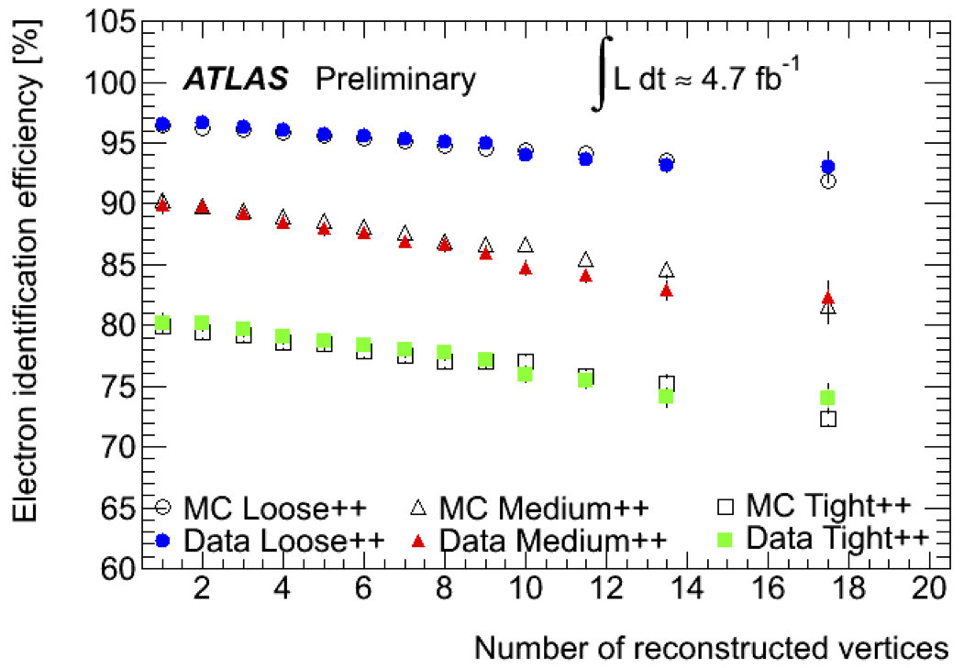
A few performance figures: (i) electrons
Electron identification efficiencies:
(based on measurements from Z → ee,
W → eν and J/ψ→ ee in data,
using the so-called “tag-and-probe” method)
Systematic uncertainty: ±6% (p_{T} ~7 GeV)
< ±2% (p_{T} ~50 GeV)
Variation of the electron efficiency with pile-up
is well modelled in the simulation
(Z → ee data vs. simulation, cuts not yet re-tuned)
Electron calorimeter energy scale:
(based on Z → ee, W → eν, J/ψ→ ee in data)
- Energy scale at m_{Z} known to ~0.5%
- Linearity better than 1% (over few GeV → few 100 GeV)
- “Uniformity” (constant term of resolution): 1% (barrel) -1.7 % (end-cap)

Slide 9
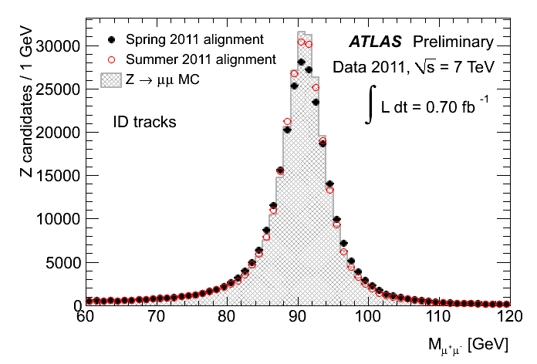
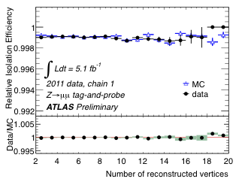
A few performance figures: (ii) muons
Muon isolation efficiency (in calorimeter),
measured from Z → μμ events in data
and Monte Carlo simulation
Improved Z → μμ mass resolution
via improved alignment
MC (perfect): 2.31 ± 0.01 GeV
Data Spring 2011 : 2.89 ± 0.01 GeV
Data Summer 2011: 2.45 ± 0.01 GeV

Slide 10
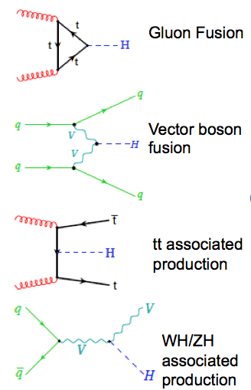
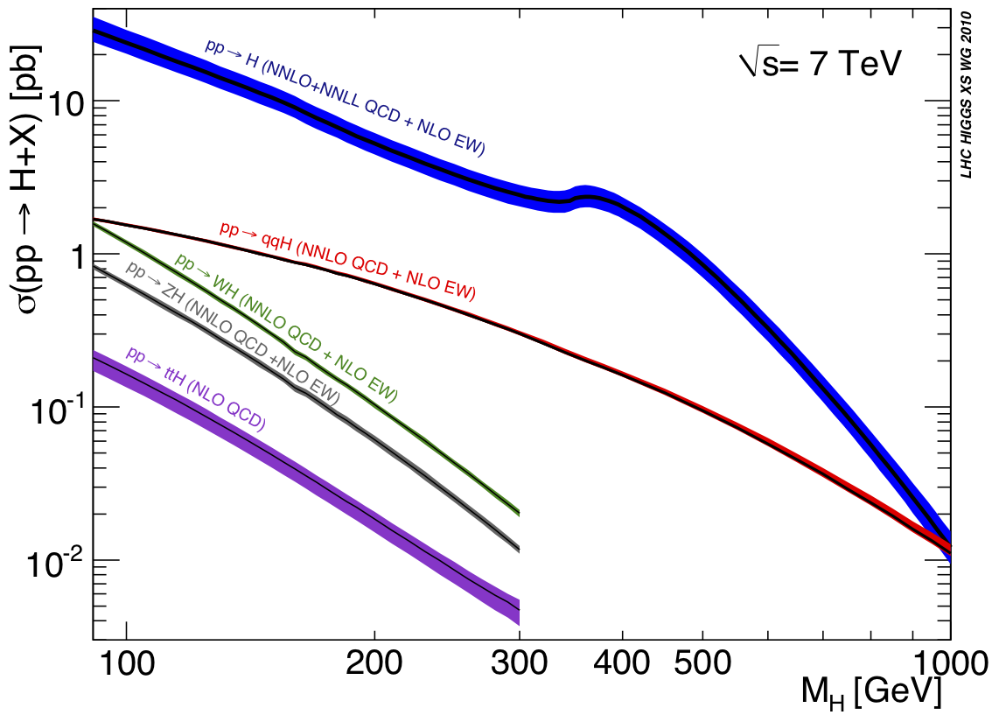
Higgs boson production cross sections
LHC Higgs cross-section working group, 2010, arXiv: 1101.0593
ATLAS Higgs boson signal simulation:
POWHEG Monte Carlo + PYTHIA for showering and hadronization
Cross sections normalized to calculations of LHC Higgs cross-section working group
(NNLO+NNLL for gg, NNLO for VBF and VH processes)
Reweighting of Higgs boson p_{T} spectrum in gg process (De Florian et al, arXiv:1109.2109)
Uncertainties according to the recommendations of the LHC Higgs cross-section group

Slide 11
Overview on ATLAS analyses
Channel | Mass range (GeV) | L_{int} (fb⁻¹) | Main backgrounds
Low mass:
H → γγ | 110 – 150 | 4.9 | γγ, γj, jj
H → ZZ*→ 4ℓ | 110 - 180 | 4.8 | ZZ*, tt, Zbb
H → WW^{(*)} → ℓν ℓν | 110 – 180 | 2.1 | WW, tt, Z+jets
H → ττ → ℓℓ + … → ττ → ℓτ_{had} + .. | 110 – 140 100 - 150 | 1.1 1.1 | Z → ττ, tt Z → ττ, tt
W(Z) H → ℓν(ℓℓ) bb | 110 – 130 | 1.1 | W(Z) + jets, tt ,..
High mass:
H → WW → ℓν ℓν → ℓν qq | 180 – 300 240 - 600 | 2.1 1.1 | WW, tt, Z+jets W+jet, tt, jets (QCD)
H → ZZ → 4ℓ → ℓℓ νν → ℓℓ qq | 180 – 600 200 – 600 200 – 600 | 4.8 2.1 2.1 | ZZ ZZ, tt, Z+jets Z+jets, tt
Searches in γγ and 4ℓ final states are based on the full data set
Updates of the other channels expected for Moriond 2012
(requires a solid understanding of more complex signatures at high luminosity, e.g. E_{T}^{miss})

Slide 12
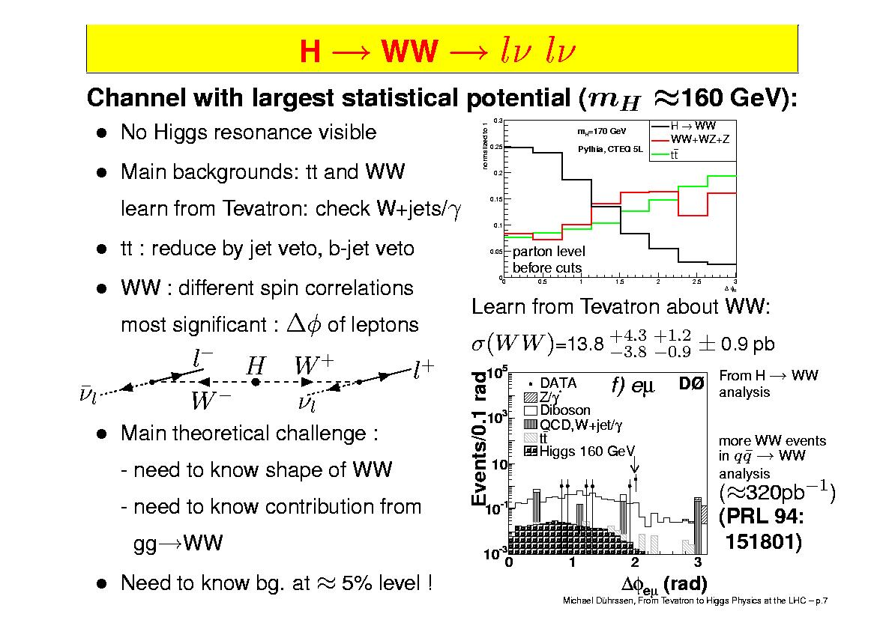
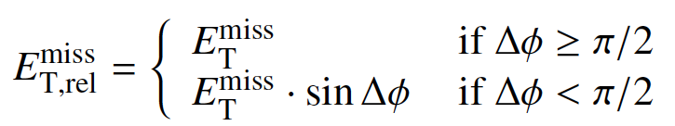
Search for H → WW → ℓν ℓν
Most sensitive channel over ~130 – 180 GeV
(large H → WW branching ratio around 160 GeV)
Clean signature of two isolated leptons, large E_{T}^{miss},
Topological cuts against the “irreducible” WW background
(Δφ_{ℓℓ} , p_{T}(ℓℓ), m_{ℓℓ} -due to spin-0 of Higgs boson-)
However, two neutrinos in final state, no mass peak → counting experiment
Important: - understanding of missing transverse energy and
- backgrounds in the signal region (transverse mass)
E_{T}^{miss} distribution after basic lepton
requirements: p_{T} > 25 / 15 GeV
m_{ℓℓ} > 15 GeV
well described (several components),
dominated by real E_{T}^{miss} above ~50 GeV;
(no large tails from fake E_{T}^{miss} visible)

Slide 13
Search for H → WW → ℓν ℓν (cont.)
Additional cuts: Z-mass veto: |m_{ℓℓ} –m_{Z} | < 15 GeV (ee, μμ)
E_{T,rel} ^{miss} > 40 GeV (ee,μμ), > 25 GeV (eμ)
Split according to jet multiplicity → multiplicity distribution well described
(E_{T} > 25 GeV) → background composition depends on # jets
Use control regions with small signal
contamination in data to constrain
the backgrounds
Use Monte Carlo to extrapolate into
the signal region
Control region | MC expectation | Observed in data
WW 0-jet | 296±36 | 296
WW 1-jet | 171±21 | 184
Top 1-jet | 270±69 | 249

Slide 14

Search for H → WW → ℓν ℓν (cont.)
Transverse mass distributions for the 0- and 1-jet events after additional
topological cuts (Δφ_{ℓℓ} < 1.3, m_{ℓℓ} < 50 GeV)
Number of events after final cuts: 0.75 m_{H} < m_{T} < m_{H}
m_{H} = 130 GeV | 0-jet | 1-jet
Observed in data | 67 | 27
Expected background | 56 ± 10 | 20 ± 3
Expected signal | 14 ± 3 | 4.9 ± 1.1
Dominant syst. uncertainties:
background normalization
(statistics in control regions)
cross sections, pdfs
energy scales, E_{T}^{miss}

Slide 15
H → WW → ℓν ℓν: sensitivity and exclusion
Cross sections σ₉₅ that can be excluded
with a C.L. of 95%, normalized to the
Standard Model cross sections
p₀: consistency of the data with the
background-only hypothesis
2σ
1σ
Expected from a
SM Higgs boson at given m_{H}
Excluded mass regions (95% C.L.): 145 < m_{H} < 206 GeV
(Expected exclusion: 134 < m_{H} < 200 GeV)
Observed limit within 2σ of expected, maximal deviation: 1.9σ for a mass around 130 GeV
The observed limits at neighboring mass points are highly correlated due to the limited mass resolution in this final state. The discontinuities in the expected and observed limits at 170 and 220 GeV are caused by a change of the selection cuts at these points

Slide 16
Search for H → γγ
One of the important discovery channels at low mass
Mass reconstruction possible, needs good γγ mass resolution and direction
measurement of photons
Challenges:
- signal-to-background ratio
(small, but smooth irreducible γγ background)
- reducible backgrounds from γj and jj
(several orders of magnitude larger than irreducible one)
Large amount of material in the LHC trackers;
requires the reconstruction of converted photons
q
γ
q
γ
q
γ
g
γ
q
π⁰
γ

Slide 17
A γγ event in ATLAS
Event selection:
2 photons within |η| < 2.4 and E_{T} (γ₁, γ₂) > 40, 25 GeV
(exclude transition region between
barrel and endcap calorimeters)
Isolation criteria in tracker
and calorimeters
(calo: < 5 GeV in ΔR < 0.4)
Important detector features:
- longitudinal (and lateral) segmen-
tation of the EM calorimeter is used
to measure the photon polar angle θ
(important at high pile-up)
- reconstruction of conversions in
silicon detectors and transition
radiation tracker

Slide 18
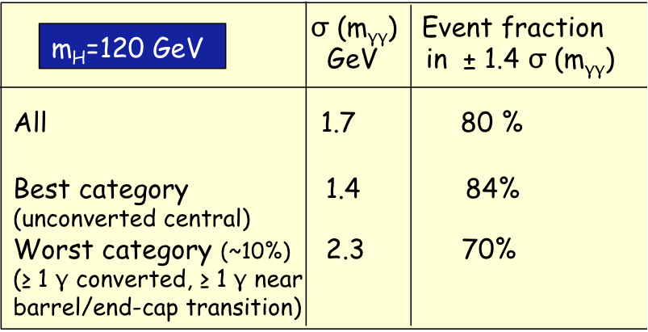
A few γγ performance figures
Di-photon events are classified in 9 categories, based on η, conversion status
and di-photon momentum component (P_{Tt}) transverse to the di-photon thrust axis
Photon energy scale and resolution
transported from electron studies using
Monte Carlo simulation
(main systematics due to material effects)
Signal description by a Crystal ball function
+ a Gaussian for tails
Mass resolution shows no sensitivity to
pile-up

Slide 19
Measured γγ mass spectrum
-after all selection cuts, summed over 9 categories-
Background model: exponential function,
determined directly from data
(different models have been used
→ systematics)
Excess of events seen around
m_{γγ} ~126 GeV
Use statistical analysis to quantify excess
incl. systematic uncertainties on
background and signal modelling
(γγ mass resolution, γγ p_{T} modelling, …)

Slide 20
H → γγ : composition of the γγ continuum background
 | Number of events | Fraction
γγ | 16000 ± 1120 | 71 ± 5%
γj | 5200 ± 890 | 23 ± 4%
jj | 1130 ± 600 | 5 ± 3%
Z/γ* | 165 ± 8 | 0.7 ± 0.1%

Slide 21
H → γγ: sensitivity and exclusion
Maximum deviation from background-only expectation observed for
m_{H}~126 GeV:
- local p₀-value: 0.27% or 2.8σ (expect 1.4σ from SM Higgs boson)
- global p₀-value*: ~7% or 1.5σ
Small mass ranges from 114 – 115 GeV and 135 – 136 GeV excluded
* The global p₀ value takes into account the probability that such an excess can appear anywhere in the
investigated mass range from 110 to 150 GeV (“Look-Elsewhere Effect’’, LEE)

Slide 22
H → γγ : p₀ values for different background models
Hybrid: high P_{Tt} categories are fitted with 2nd order Bernstein polynomials, the other
categories with a single exponential;
Bernstein: all categories are fitted with the Bernstein function

Slide 23
Search for H → ZZ^{(*)} → 4ℓ
“Golden channel” over a large mass range;
Starts to get sensitivity with the present integrated luminosity
Mass reconstruction possible, need good lepton identification and measurement
down to low p_{T} (to maximize the acceptance for low m_{H})
Low signal rate, but also small backgrounds
- ZZ^{(*)} continuum as irreducible background
- Top and Zbb production as reducible backgrounds (at low mass)
(suppressed via lepton isolation and impact parameter cuts)
ATLAS selection cuts: require 4 identified leptons (4e, 2e2μ or 4μ) with:
P_{T} (1,2) > 20 GeV (high trigger acceptance)
P_{T} (3,4) > 7 GeV
|η| < 2.47 (e) and ~2.5 (μ)
Isolation and impact parameter requirements
on the two softest leptons
m₁₂ = m_{Z} ± 15 GeV
m₃₄ > 15 – 60 GeV (for m_{H} in the range 120 - 200 GeV )
Signal acceptance x efficiency ~15% (m_{H} = 125 GeV)

Slide 24
Expected mass resolutions (for m_{H} = 130 GeV):
- Width dominated by experimental resolution: ~2.5 GeV for 4e
~2.0 GeV for 4μ
(no Z mass constraints used in the fit)
- Event fractions outside ±2σ at the level of 15-18%

Slide 25
Measured 4ℓ mass spectra
Mass range | Full | < 180 GeV | 117 – 128 GeV
Observed in data | 71 | 8 | 3
Expected background | 62 ± 9 | 9.3 ± 1.5 | 1.5 ± 0.3
Main systematic uncertainties
Higgs cross-section : ~ 15%
Electron efficiency : ~ 2-8%
ZZ* background : ~ 15%
Zbb, +jets backgrounds : ~ 40%
Expected signal contribution for m_{H}=125 is ~1.5 events
Three events observed around 124 GeV: 2 (2e2μ)− and 1 (4μ)-event

Slide 26
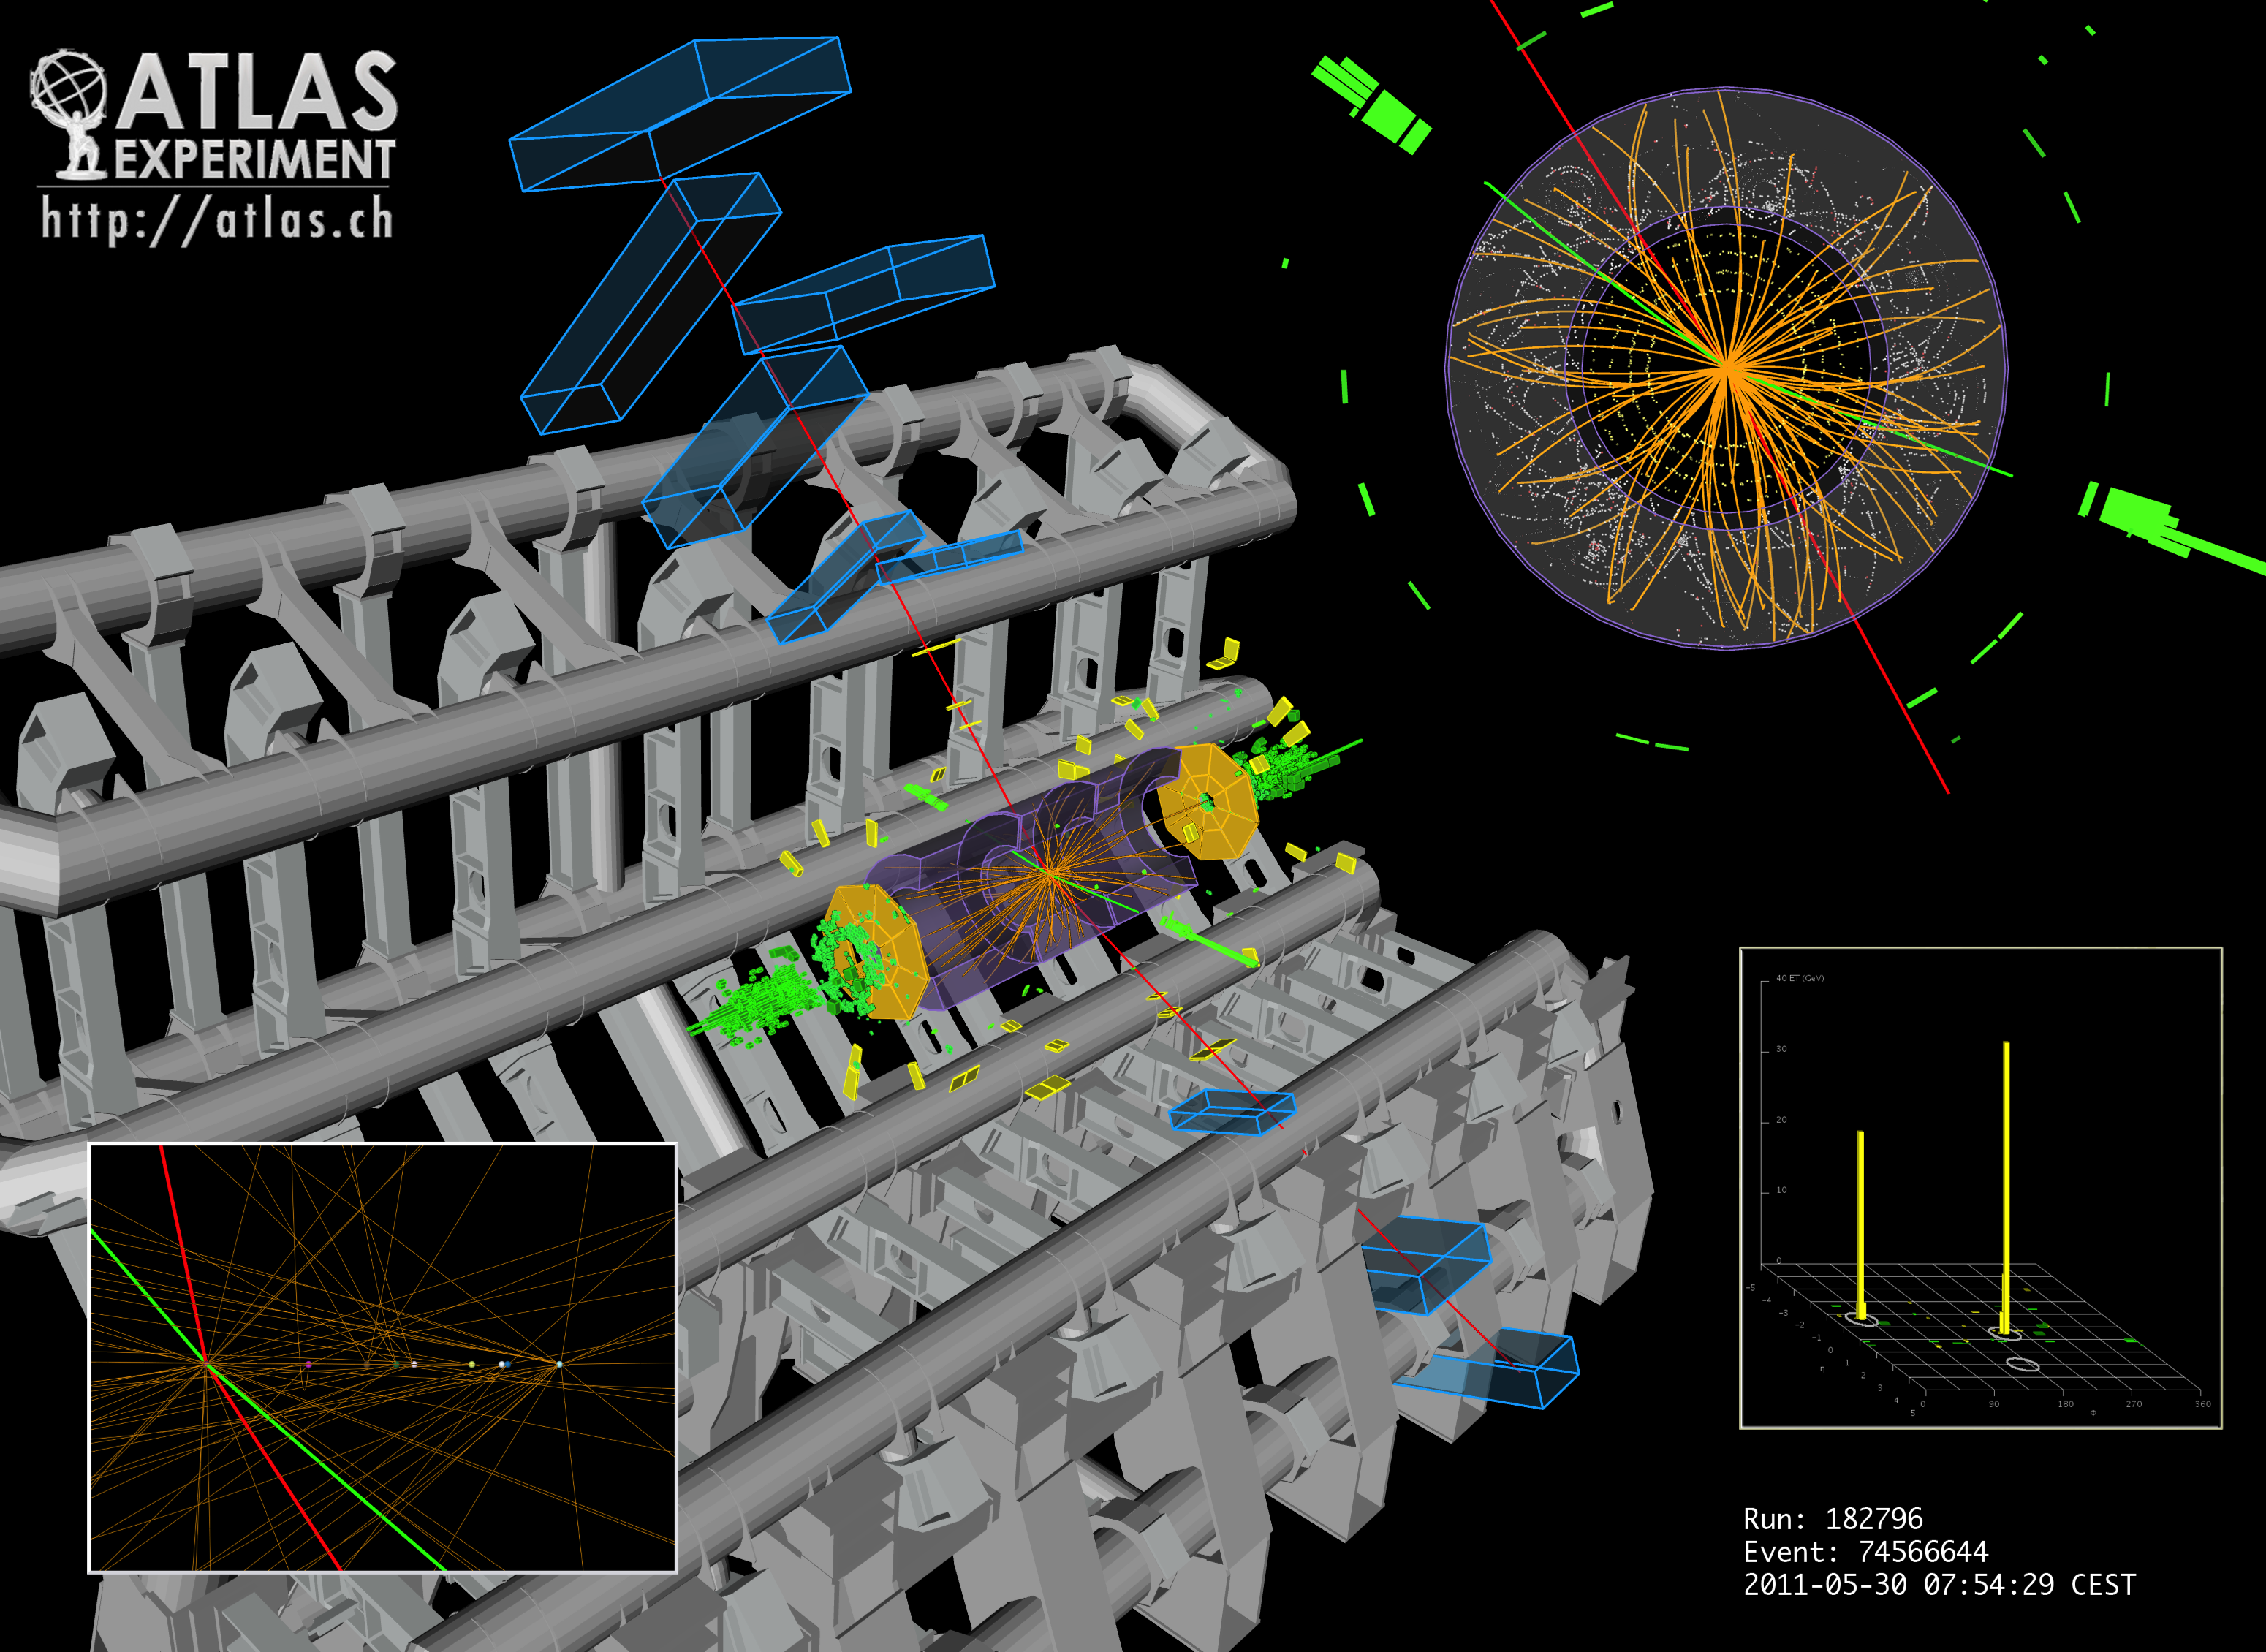
p_{T} (e⁺,e⁻,μ⁻,μ⁺)= 41.5, 26.5, 24.7, 18.3 GeV
m_{e+e-}= 76.8 GeV, m_{μ+μ-} = 45.7 GeV
m_{4l} = 124.3 GeV

Slide 27
H → ZZ^{(*)} → 4ℓ: sensitivity and exclusion
Excluded mass regions (95% C.L.): [135-156], [181-234] and [255-415] GeV
(Expected exclusion: 137< m_{H} < 158 GeV and 185< m_{H} < 400 GeV)

Slide 28
Test of background-only hypothesis for the 4ℓ channel
Small probabilities for background-only hypothesis observed for:
m_{H} (GeV) | local (global) p₀ | Local significance | Expected signif. from SM Higgs
125 | 1.8% (~50%)** | 2.1 σ | 1.4 σ
244* | 1.1% (~50%) | 2.3 σ | 3.2 σ
500 | 1.4% (~50%) | 2.2 σ | 1.5 σ
*) already excluded by the ATLAS + CMS combination
**) Look-elsewhere-effect evaluated over the mass range 110 – 600 GeV

Slide 29
Summary of Search Results in the
High Mass Region

Slide 30
Results from ATLAS on various high mass search channels: L = 1.04 – 4.8 fb⁻¹
H → ZZ → 4ℓ
H → ZZ → ℓℓ qq
H → ZZ → ℓℓ bb
H → WW → ℓν qq
H → ZZ → ℓℓ νν
Also in these channels: data are consistent with expectations from Standard Model
background processes → work out significances / statistics

Slide 31
Summary of the current status of the
Higgs boson search in ATLAS
- excluded cross sections by individual channels -

Slide 32
The grand combination
Channels included:
H → γγ, H→ ττ
H → WW^{(*)}→ ℓν ℓν
H→ WW→ℓν qq
H → ZZ^{(*)} → 4ℓ,
H→ ZZ → ℓℓ νν
H → ZZ → ℓℓ qq,
H→ WW→ℓν qq
Not included:
W/ZH→ ℓbb+X
Excluded mass regions:
95 % C.L. | 99 % C.L.
112.7 – 115.5 GeV
131 – 237 GeV | 133 – 230 GeV
251 – 468 GeV | 260 – 437 GeV
95% C.L. expected exclusion: 124.6 – 520 GeV

Slide 33
Consistency of the data with the background-only expectation
Expected from a
SM Higgs boson at given m_{H}
Lowest probability (p₀ = 1.9 10⁻⁴) for background-only expectation observed
for m_{H} ~126 GeV
Local significance of excess: 3.6σ (2.8σ H → γγ, 2.1σ H → 4ℓ, 1.4σ H → ℓν ℓν )
Global significances: 2.5σ (p = 0.6%) Look-elsewhere-effect over 110 – 146 GeV
2.2σ (p = 1.4%) Look-elsewhere-effect over 110 – 600 GeV

Slide 34
Compatibility of the observation with the expected strength of
a Standard Model Higgs boson (combination of γγ, 4ℓ, ℓνℓν)
Signal strength: μ = σ / σ_{SM} (fit value)
Observed signal strength is compatible with the expectation from a
Standard Model Higgs boson, within errors
These best fit values do not account for energy scale systematic uncertainties

Slide 35
Compatibility of the observation with the expected strength of
a Standard Model Higgs boson (individual channels)
Signal strength: μ = σ / σ_{SM} (fit value)
- The observed excess in the γγ channel
is a factor of (2 ± 0.8) larger than expected
Excess in the 4ℓ and ℓν ℓν channels, as well
as for the combination are compatible within 1σ

Slide 36
A short summary of recent results on searches for
non-Standard Model Higgs bosons
Search for MSSM Higgs bosons in ττ final states
Search for fermiophobic Higgs bosons

Slide 37
Search for A/H → τ τ
The production of neutral Higgs bosons A/H is enhanced at large tanβ in the
MSSM
Search for A/H → τ τ decays in four final states, characterized by the τ decays:
- A/H → ττ → eνν μνν
- → ττ → eνν τ_{had}ν and μνν τ_{had}ν
- → ττ → τ_{had}ν τ_{had}ν
Good τ identification required, m_{ττ} reconstructed via visible mass or using the
missing mass calculation technique
L = 1.06 fb⁻¹
e μ
l τ_{had}
τ_{had} τ_{had}
- Select 4630 events in data
- Expectation from SM background sources: 4900 ± 600

Slide 38
Cross section limits and excluded mass regions in the MSSM parameter space
Expected and observed limits on
• BR ( φ → ττ) for a generic
Higgs boson φ
Expected and observed exclusion limits in
the MSSM (m_{A} – tanβ) plane
m_{h}^{max} scenario

Slide 39
Search for a fermiophobic Higgs boson in the γγ decay mode
Benchmark model considered: - all fermion couplings set to 0
- bosonic couplings kept at the SM values
→ modified Higgs production and decay branching ratios,
e.g. no contributions from the gluon-fusion and ttH associated production modes
Higgs production with decays to
γγ is larger than in the SM for m_{H} < 120 GeV
Perform analysis similar to SM H → γγ search
VBF and VH production → higher transverse
momentum due to recoiling jets or vector bosons

Slide 40
L = 1.08 fb⁻¹
No excess of events above Standard Model background (for different p_{T} categories) → exclusion limits
Excluded mass regions:
110 – 111 GeV and
113.5 – 117.5 GeV
Expected exclusion: 110 – 116 GeV

Slide 41
Summary and conclusions
The operation of the LHC and of the ATLAS experiment in 2011 was superb
LHC has reached sensitivity for the Standard Model Higgs boson and first
exclusions beyond the LEP and Tevatron limits have been presented by ATLAS and CMS
The ATLAS experiment has restricted the allowed mass range for the Standard
Model Higgs boson to three regions (with 95% C.L.):
115.5 < m_{H} < 131 GeV .or. 237 < m_{H} < 251 GeV .or. m_{H} > 468 GeV
The data are consistent with the expectations from Standard Model background
processes, however, a low background-only probability of 0.6% (2.5σ), after
correcting for the look-elsewhere-effect, is found for m_{H} ~126 GeV
The fitted signal strength for a signal + background hypothesis at that mass
in the three most important channels (H →γγ, H → ZZ → 4ℓ and H → WW → ℓν ℓν)
is consistent with the Standard Model value, within errors.
More data and a combination with the CMS experiment are needed to draw
definite conclusions
2012 is going to be an exciting year for all of us !!

Slide 42
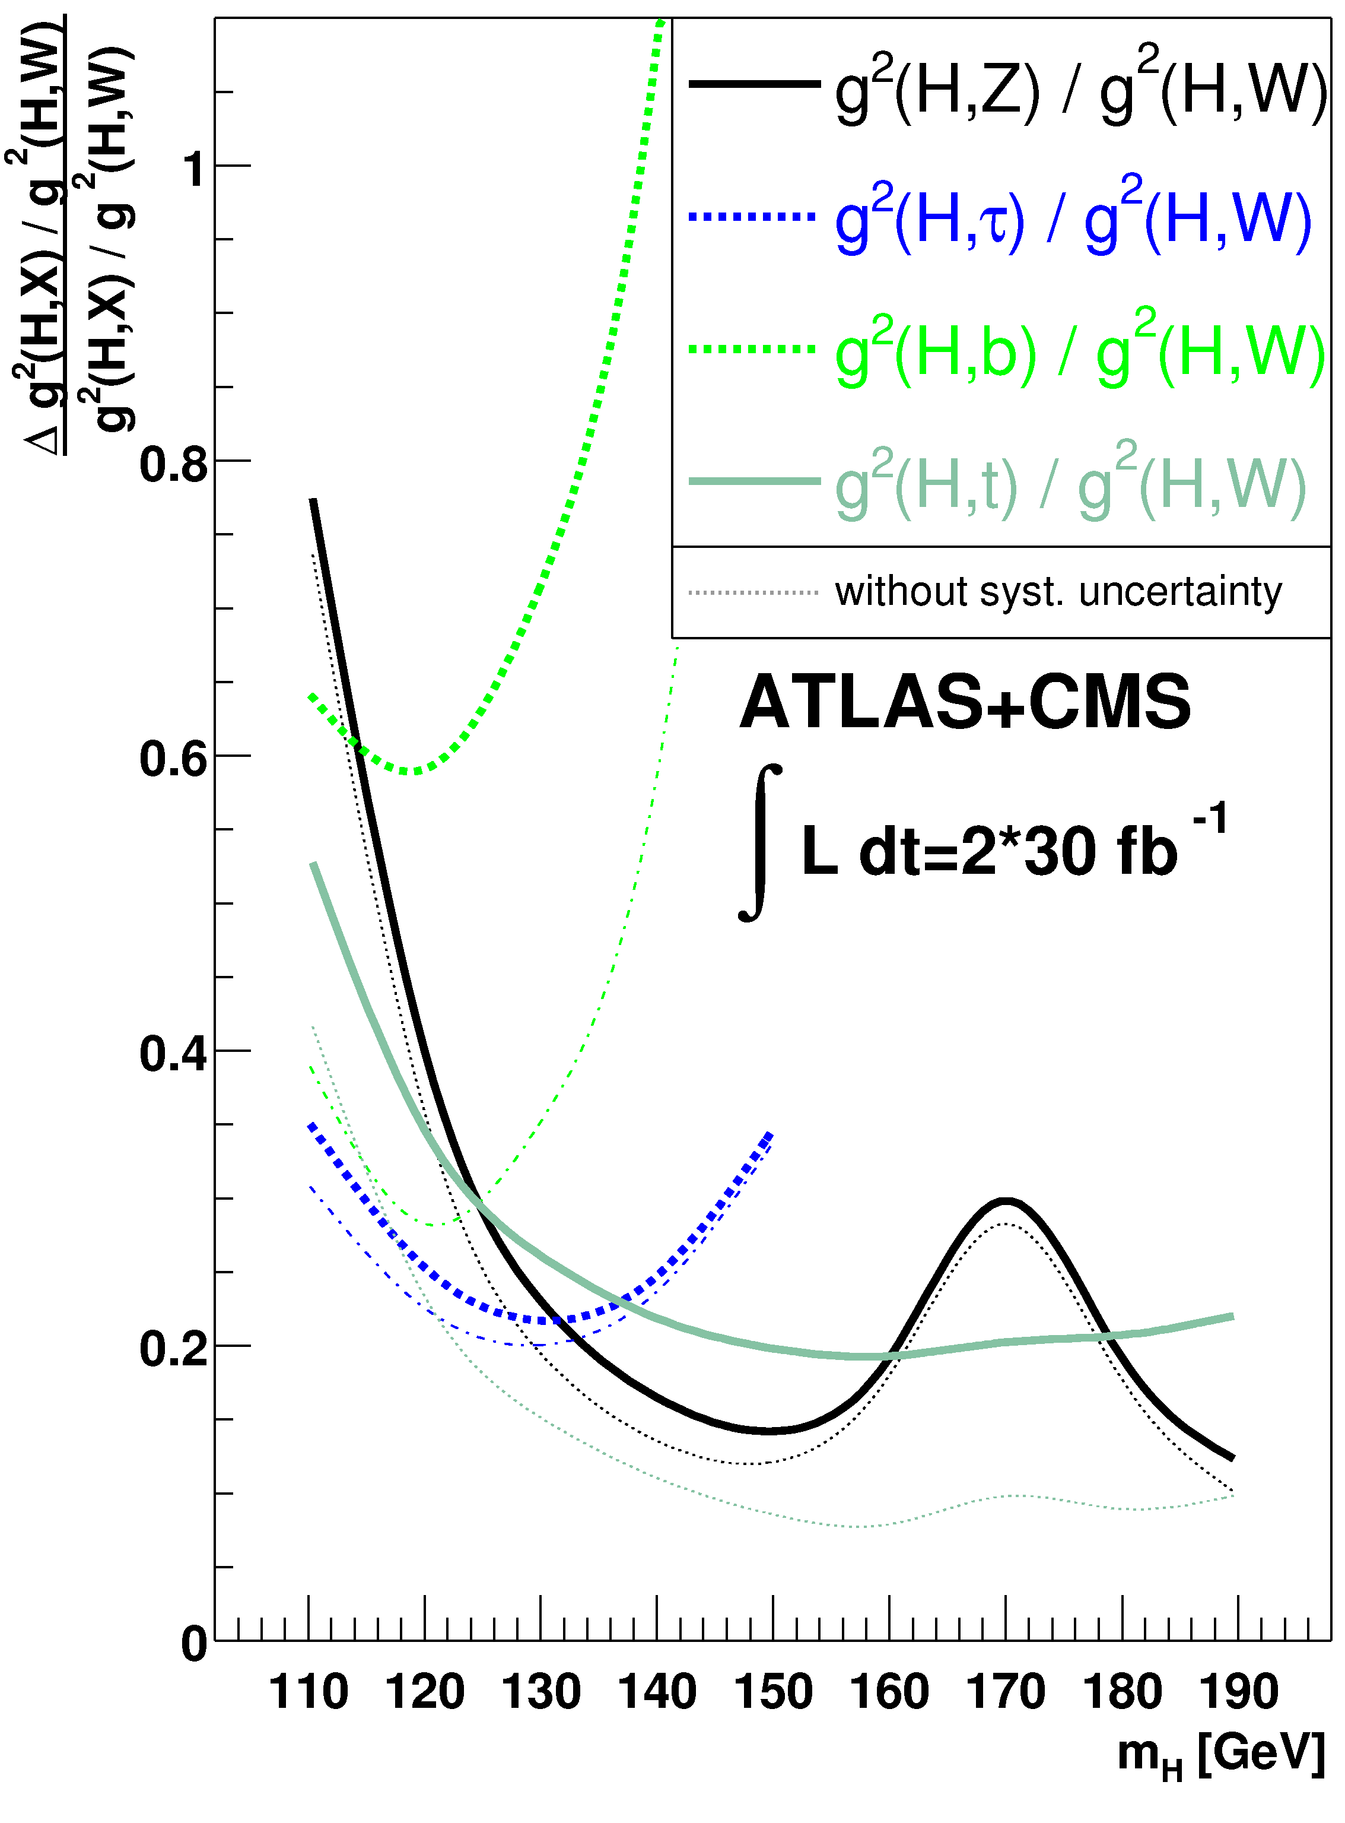
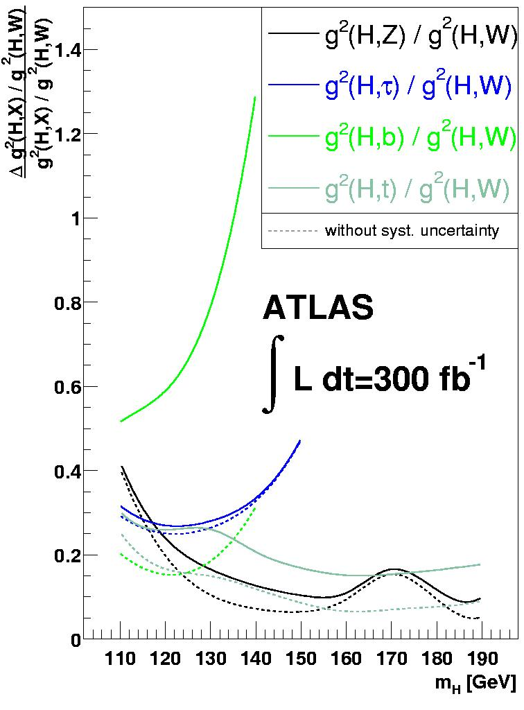
Step 2: measurement of ratios of couplings:
124-126 GeV would be a nice Higgs mass to have !
→ Zürich Higgs workshop 2009
Additional assumption: particle content in the gg- and γγ-loops are known;
Information from Higgs production is now used as well;
Important for the determination of the top-Yukawa coupling

Slide 43
Backup Slides

Slide 44
γγ mass spectra for the nine categories
-unconverted-

Slide 45
γγ mass spectra for the nine categories (cont.)
-converted-

Slide 46
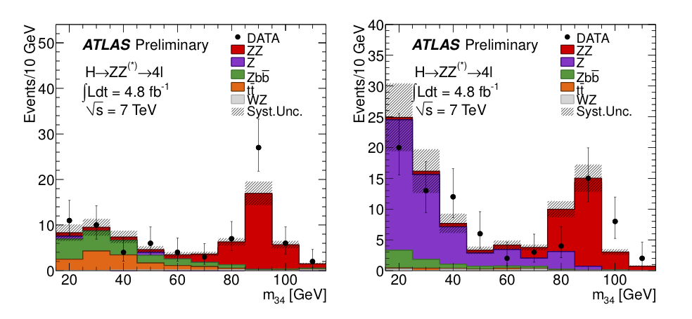
Reducible backgrounds from Zbb, Z+jets, tt giving 2 genuine + 2 fake leptons measured
using background-enriched and signal-depleted control regions in data
(chose a compromise between statistics and “purity”)
Zbb+Z+jets control regions:
Select events with 2 opposite-sign same-flavour leptons, m_{ll}=m_{Z} ±15 GeV
2 additional same-flavour leptons passing all cuts but isolation and impact parameter
→ below plots of their invariant mass (m₃₄)
Z + μμ
Z + ee
Low-mass regions dominated by Zbb (Z+μ⁺μ⁻ sample ) and Z+jet (Z+e⁺e⁻ sample)
Data well reproduced by MC (within uncertainties)
Samples of Z+μ and Z+e then used to compare
efficiencies of isolation and impact parameter
cuts between data and MC → Good agreement
MC used to estimate background contamination in signal region
Data MC
Z+μ 20±1% 20.3± 0.4%
Z+e 29.9±0.6% 30.4± 0.4%

Slide 47
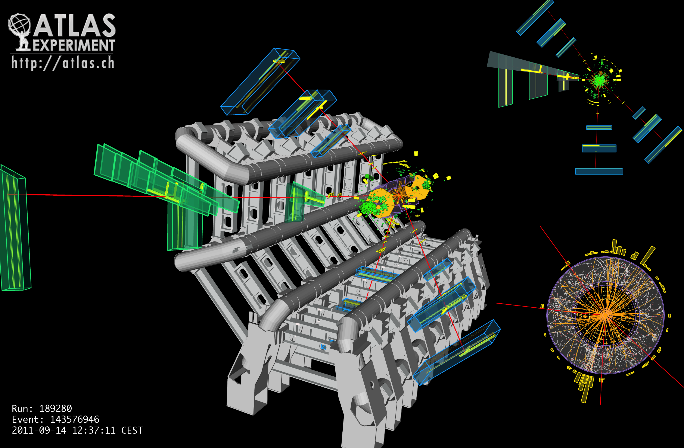
p_{T} (μ⁻, μ⁺, μ⁺, μ⁻)= 61.2, 33.1, 17.8, 11.6 GeV
m₁₂= 89.7 GeV, m₃₄= 24.6 GeV, m_{4μ} = 124.6 GeV

Slide 48
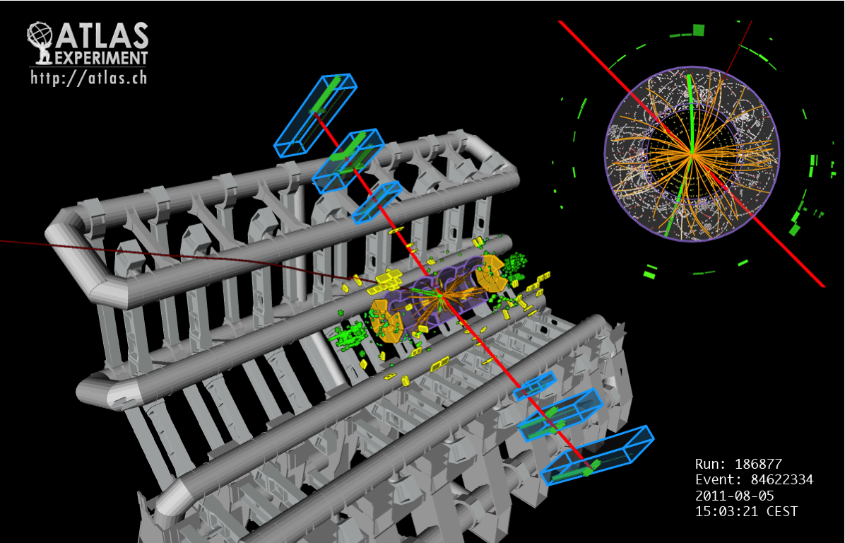
p_{T} (μ⁻,μ⁺,e⁻,e⁺) = 43.9, 43.5, 11.2, 9.9 GeV
m_{μ+μ-} = 89.3 GeV, m _{e+e-} = 30 GeV, m_{4l} = 123.6 GeV

